Slide 1
“Johnson’s Algorithm”
Emiliano Santos Galindo Janet.
Artificial Intelligence Engineering.

Slide 2
What is the Johnson’s Algorithm?
We are given a weighted directed graph G = (V , E ).
This is a graph algorithm of search; this algorithm finds the shortest paths between all pairs of nodes, that is to say that from node A it finds the shortest path to all the other nodes, and does the same with the other nodes.
This algorithm is meant for sparse graphs

Slide 3
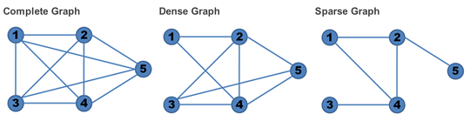
Wait! But… What is a sparse graph?
You can classify graphs according to the number of edges, and it goes as it follows:

Slide 4
Description
It makes its way to the solution by using other two algorithms, Bellman-Ford and the Dijkstra.
It was published by Donald B. Johnson (Ha, anybody saw that last-name coming?), who published it in 1977.
As you have recognize it does the same as the Floyd-Warshall algorithm, but this algorithm gives a little twist to the classic ways of approach.

Slide 5
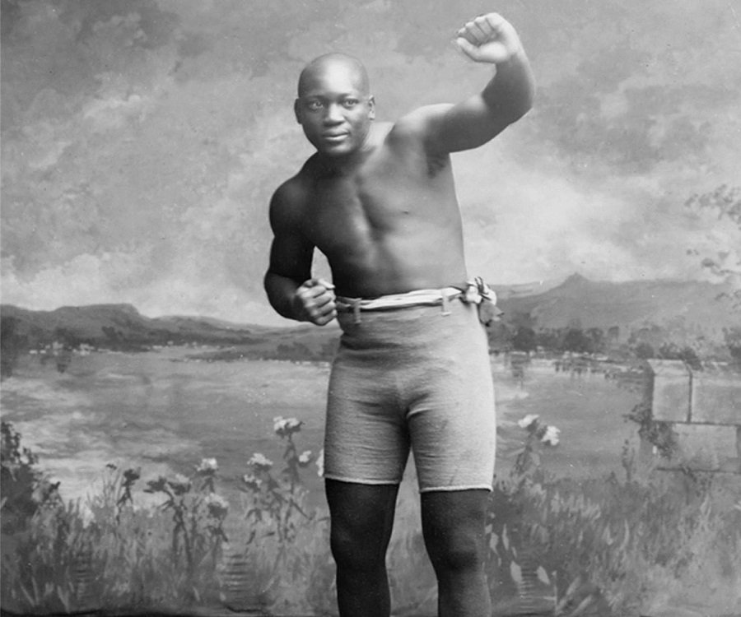

THIS IS A FIGHT!
VS
Jack Johnson
Floyd Mayweather

Slide 6
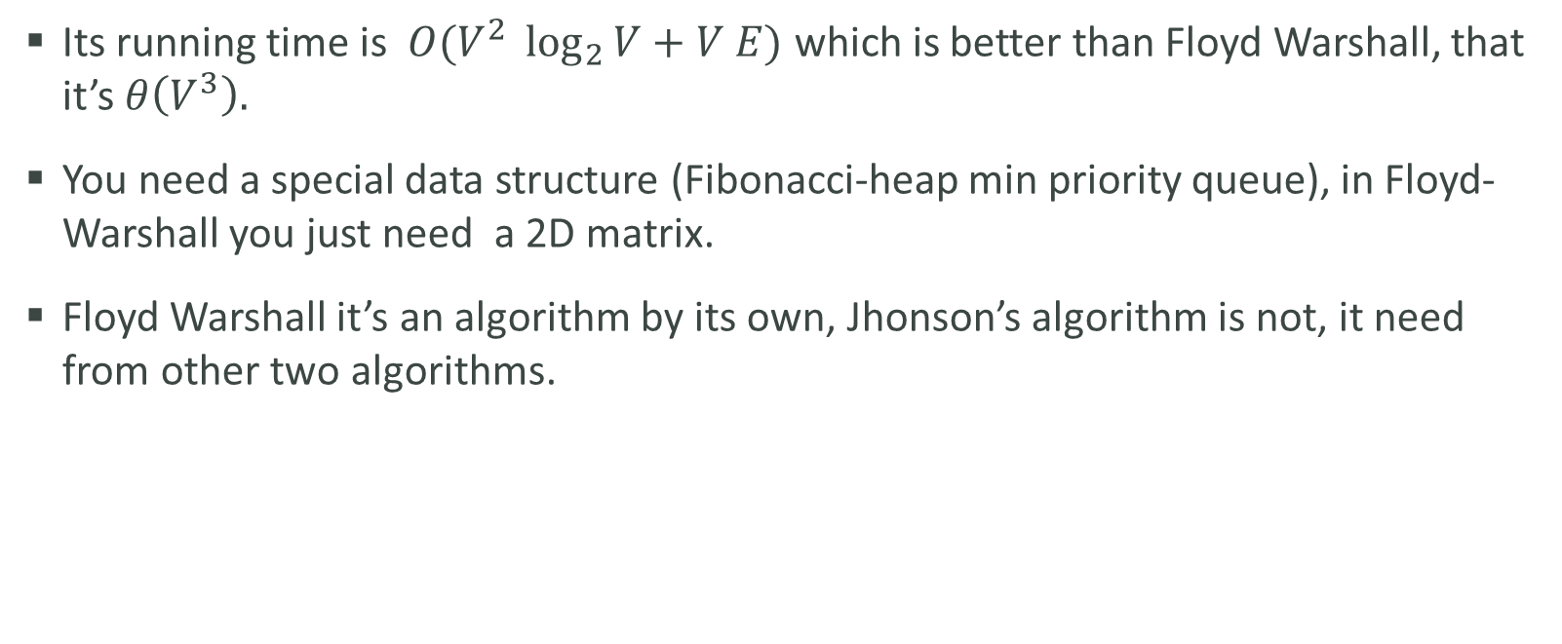
Comparing
Its running time is $O(V^{2} \log_{2}{V+V E)}$ which is better than Floyd Warshall, that it’s $θ\left(V^{3}\right).$
You need a special data structure (Fibonacci-heap min priority queue), in Floyd-Warshall you just need a 2D matrix.
Floyd Warshall it’s an algorithm by its own, Jhonson’s algorithm is not, it need from other two algorithms.

Slide 7
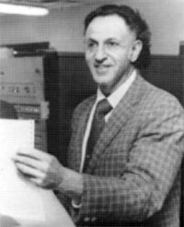
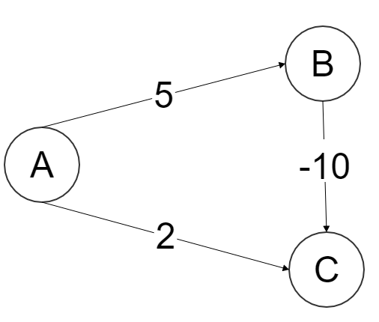
Details
Like this algorithm uses Dijkstra to find the paths it can’t be executed with negative weights in your edges, so for this reason is that we are going to first use the Bellman-Ford algorithm to reweight this edges to non-negative.
Richard Bellman

Slide 8
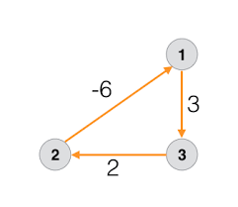
Details
This algorithm returns a matrix of shortest-path weights.
Constraint: This algorithm can not be executed with graphs with negative cycles
Negative Cycle:

Slide 9
Analisis
Giving a close look to this algorithm, it is like only using Dijkstra for each node.
Wait, but what is the point? The point is that this algorithm enables Dijkstra to also compute in graphs with negative weighted graphs by using the BellmanFord
Also it uses a different data structure and also it is meant for sparse graphs so the complexity remains good.

Slide 10
Steps
1.- Create an auxiliary node and make it adjacent to all of your nodes.
2.- Run Bellman-Ford algorithm to find shortest paths from your auxiliary node to all to the others.
3.- Reweight the Graph
4.- Run Dijkstra V times, once for every node in your graph.

Slide 11
